Slide 1
www.MINEPORTAL.in
ONLINE TEST SERIES FOR
DGMS COAL/METAL FIRST/SECOND CLASS EXAM
GATE MINING EXAM
OVERMAN EXAM TEST
MINING INSPECTOR EXAMS
COAL INDIA MTs & OTHER PSUs EXAMS
FREE STUDY MATERIAL & VIDEO LECTURES
MINING JOBS NOTIFICATIONS
www.mineportal.in Call/Whatsapp-8804777500 www.fb.com/mineportal.in

Slide 2
HEADGEAR

Slide 3
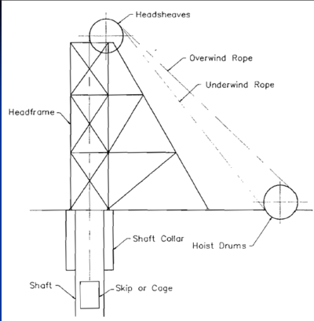
Headgear
Structural frame above an u/g mine shaft.
Consist of hoist tower, drum or friction hoisting.

Slide 4
Classifications:
Based on mode of main entry
Vertical(most commonly used)
Inclined(may be a single A framed type or two frame type)

Slide 5
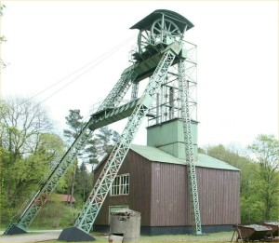

Slide 6
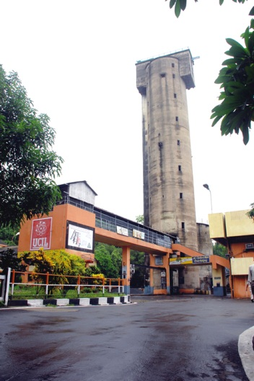
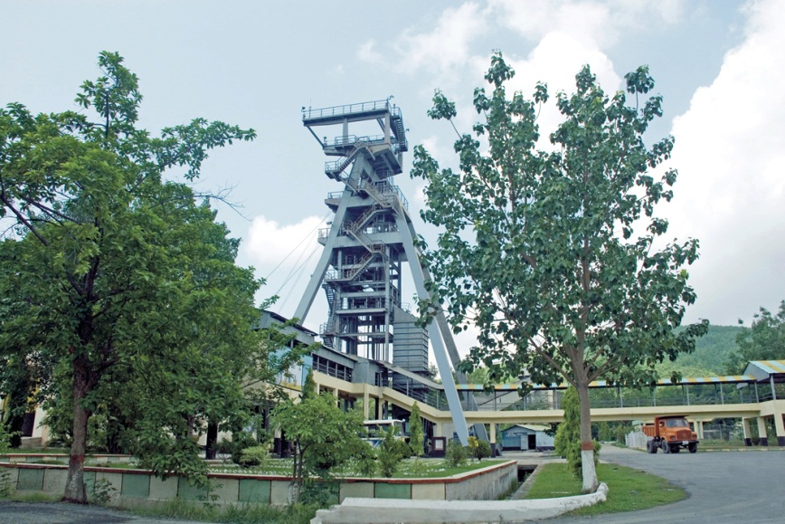
Based on material used
Timber(not in use)
Steel
Concrete
Concrete head gear, Jaduguda
Steal head gear, Narwapahar

Slide 7
STEEL HEADGEAR ADVANTAGES OF STEEL HEADGEAR
EASE IN MODIFICATION
SHOP FABRICATION SAVES TIME
DEALS WITH UNFAVOURABLE GROUND CONDITION

Slide 8
CONCRETE HEADGEAR ADVANTAGES
SLIGHTLY CHEAPER AND NO PAINTING REQUIRED
CLEAR APPROACH TO SHAFT
RIGID STRUCTURE CONTROLS VIBRATIONS

Slide 9
DISADVANTAGES
CONSTRUCTION HAMPERS OTHER OPERATIONS
DIFFICULT TO MODIFY
REPAIRING IS DIFFICULT

Slide 10
Depending on mounting of mine hoists
Ground mounted hoists
Tower type head frames with ground mounted friction hoists
Hoist towers with one or two friction hoists ( mounted on them)
Tower mounted friction hoist and ground mounted drum hoist

Slide 11
Drum hoist Friction hoist(Koepe)
Can be used for a single drum
Less maintenance as rope is attached to drum
Can be used for both inclined and vertical shafts
Used in shaft sinking purposes
Cannot
More maintenance
Suitable for large depth
Used only for vertical shafts
Cannot operate when shaft bottom is flooded as tail rope may get damaged
Less length of rope required
Less motor power required in comparison
Not suitable in shafts containing corrosive waters as they can’t be greased similar to drum winding

Slide 12
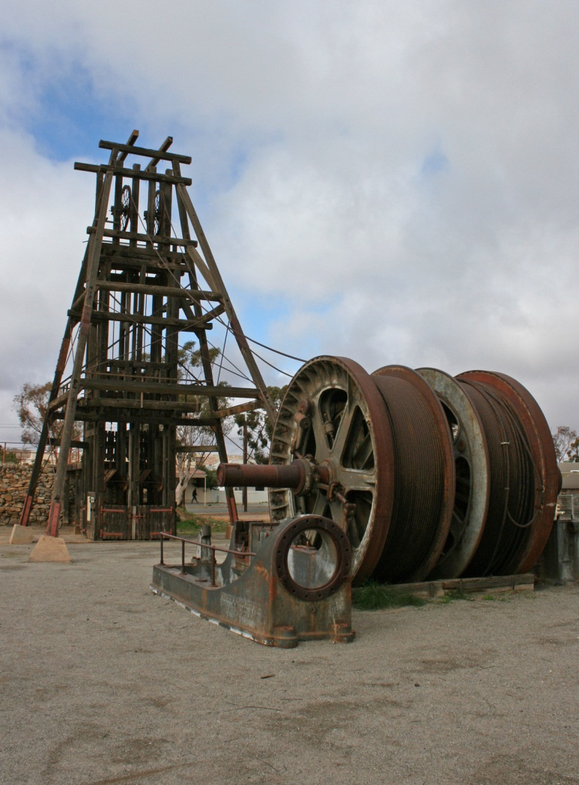
Ground mounted

Slide 13
Height of Headgear
It is determined by distance between shaft collar and centre of headgear pulley at highest level. It mainly depend upon many factors such as banking level, maximum over wined allowed up to catch plate, pit-top layout, number of deck on cage etc. It varies in range of 20-60 meters depending on above factors

Slide 14
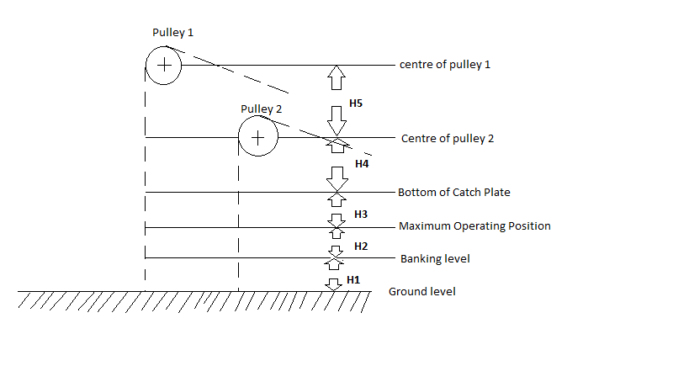
HEADGEAR ARRANGEMENT

Slide 15
Total height of headgear H = h₁+h₂+h₃+h₄+h₅
h₁=height of banking level above shaft collar (h₁=0, if banking level is at shaft collar)
h₂=maximum height of top conveyance when discharging above banking level
h₃=over wind allowance up to bumper beam / catch plate
h₄= vertical distance between bumper beam and centre of pulley
h₅=vertical distance between centres of two pulley in case of two tier arrangement (h₅=0, when either one is used or two pulleys are parallel )

Slide 16
Design of headgear
Factors affecting design

Slide 17
Height of headgear
Geological disturbances on shaft mouth
-Steel headgear is preferred over concrete headgear in geologically disturbed areas
Geometry of headgear
-Circular shape gives optimum hoisting due to high factor of safety
Depth of shaft
-It impacts duty cycle which directly affects production
Minimum structure dead load
-It depends on various factors like structure weight, pulley weight , guide vanes and tensions developed in ropes, internal steel structure supported by headgear etc
Sufficient rigidity to limit vibrations to their permissible values
Vibrations are caused by
- Translational vibration of ropes
- Longitudinal vibrations of ropes

Slide 18
Strength to withstand stress developed in various parts of headgear under
adverse loading conditions
Construction and maintenance cost
-Steel headgear is more economic in maintenance than any other type of
headgear
Durability of frame
-It depends upon material used and overall production for long time
Structural and functional requirement to suit the shaft

Slide 19
Rope Lead - Introduction
Length of rope (underlay/overlay) between hoist and head sheave
Determines maximum allowable distance between hoist and shaft
Should not exceed 60m so as to avoid large sags and harmful rope whip
Guide rollers should be installed near opening of hoistroom if Rope plane exceeds 60m
If it exceeds 75m installation of a sag tower between hoistroom and head frame, preferably at 1/3rd distance of rope length away from drum should be installed

Slide 20
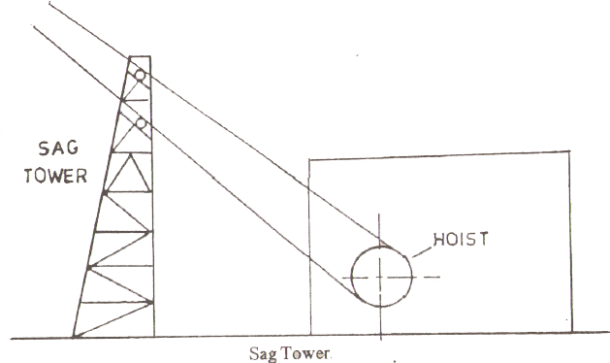
Sag tower provides a pair of light-weight idlers (<=500mm) with renewable rope treads or rubber covered rollers.

Slide 21
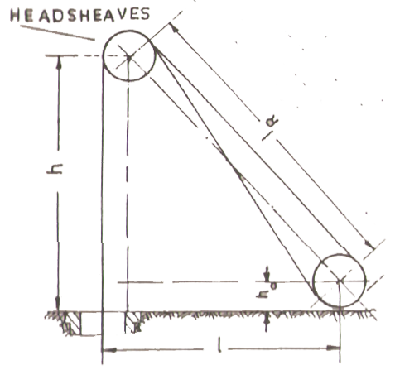
Calculation of Rope plane and rope slope
l_{R} is Rope lead or Rope plane, given by
l_{R} = sqrt[ (h-h_{o})² + (l-R_{s})² ]
h = calculated value of head frame height
l = horizontal distance between axis of drum shaft and center of shaft section
h_{o} = height of axis of drum shaft above shaft collar level
R_{s} = radius of head sheaves
Rope slope,  given by
tan  = (h-h_{o})/(l-R_{s})

Slide 22
When head sheaves are arranged in same vertical plane on separate platforms, length of Rope planes are given by
l_{R1} = sqrt[ (h-h_{o})² + (l-R_{s})² ]
l_{R2} = sqrt[ (h-∆h-h_{o})² + (l-l_{s})² ]
∆h = difference in elevation of head sheaves’ centers,
l_{s} = horizontal distance between head sheaves’ centers

Slide 23
Rope fleet angle
Determined by relative positions of mine hoist and head sheaves
Should not exceed a definite permissible value for satisfactory rope coiling and longer rope life
Friction sheave – one or no fleet angle
Drum Hoist – outer and inner fleet angles
Max Permissible fleet angle is 1º30´ for friction sheaves and smooth faced drums & 2º for grooved drums

Slide 24
Hoist Ropes

Slide 25
Desired Qualities
Strength
Resistance to bending fatigue
Resistance to abrasion
Resistance to distortion/cr-ushing
Resistance to rotation
Resistance to corrosion
Reverse Strength
Constructio-nal stretch

Slide 26
Ropes Used for Different Purposes
Winding Ropes
6x7 Lang Lay, F.C.
6x19 Seale Regular or Lang Lay, F.C.
6x21 Filler Wire Regular or Lang Lay, F.C.
6x25 Filler Wire Regular or Lang Lay, F.C.
6x27 Flattened Strand Lang Lay, F.C.
6x30 Flattened Strand Lang Lay, F.C.
Locked coil hoist Rope
Guide Rope
Half Locked Coil Guide Rope

Slide 27
Why rope diameter should be less?
Drum Diameter >= 100 x Rope diameter
Required torque = Load Torque + Rope Torque + Frictional Torque + Travelling Torque + Rotating Torque
And all the above components are directly proportional to Drum Radius.
This implies that lesser the rope radius, lesser will be the drum radius which in turn corresponds to lower torque requirement and hence lower power requirement.

Slide 28
Prepared by Group 1
Amit Tiwari 11108EN001
P. Rahul Bharadwaj 11108EN002
Anirudh Singh 11108EN003
Deepu Jha 11108EN004
Alok Rai 11108EN005
Ravi Raj Dwivedi 11108EN006
Ravi Agrawal 11108EN007
Shwetab Suman 11108EN008
Dushyant Saraswat 11108EN009
Prasoon Garg 11108EN010
Atish Kumar 11108EN011

